Slide 1


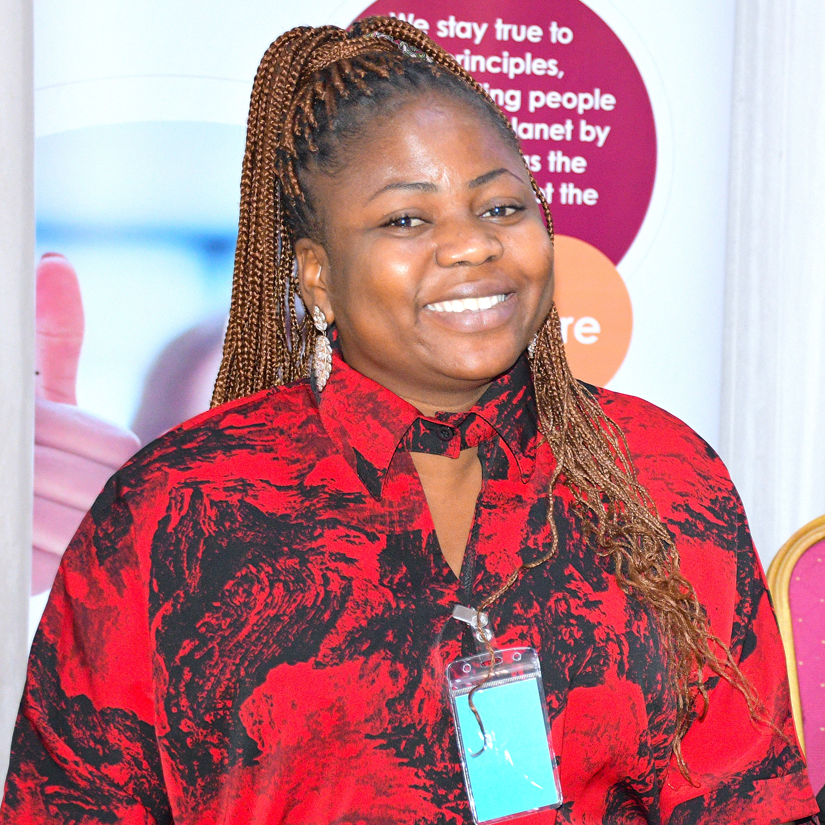
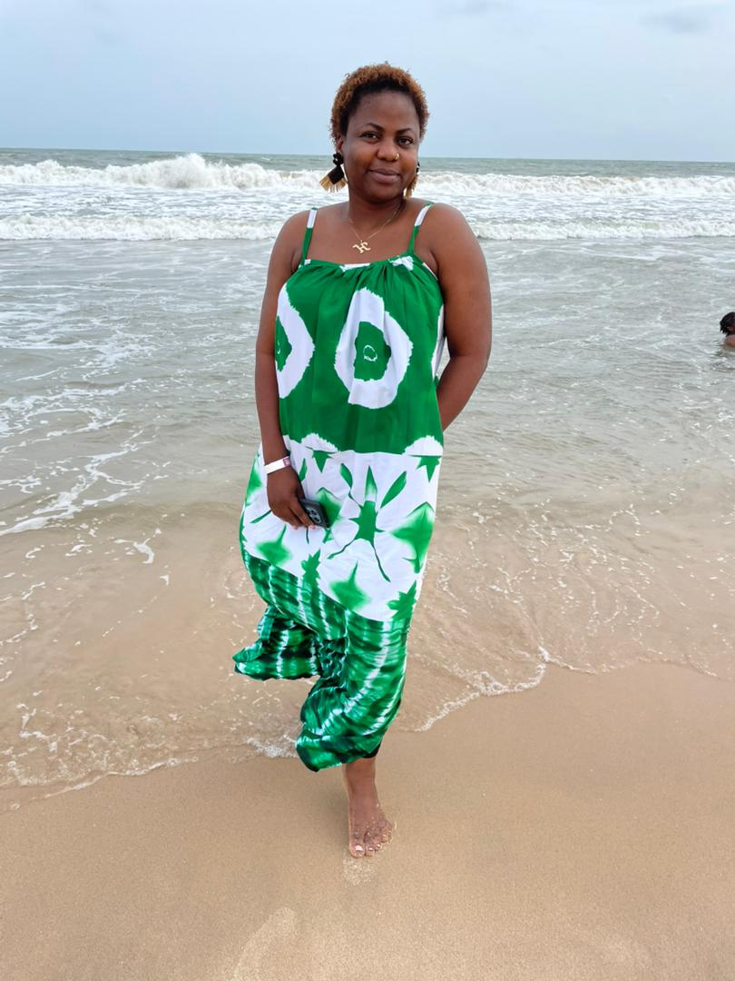
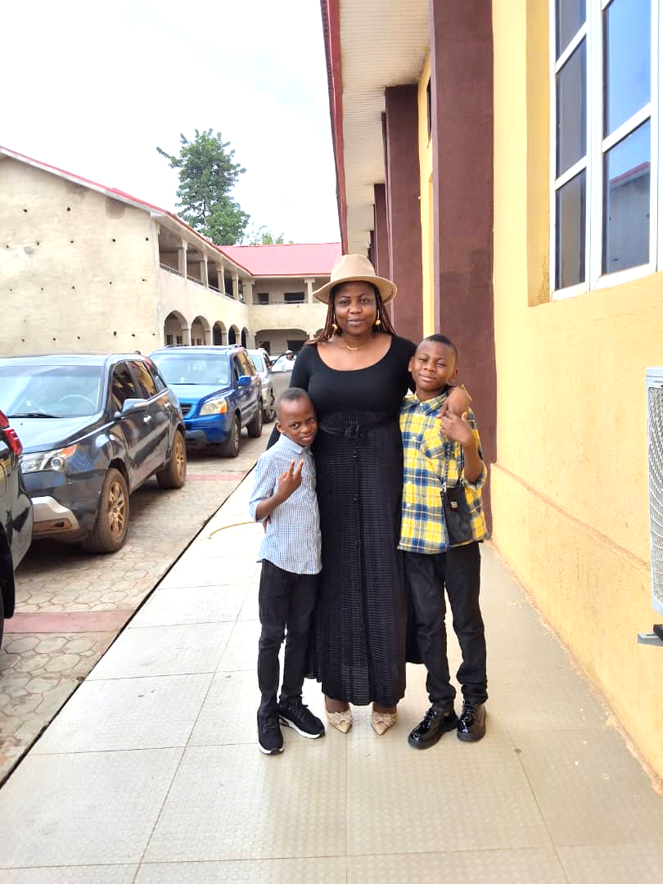
Getting to Know Me
Work
Personal
My role
AtSource Lead
Significant others / family members / furry friends in my life
Family: My cute boys, my lovely mum, my wonderful siblings and a few great friends
Tenure in ofi/Olam
3 Years
How I enjoy spending my free time
Family time, taking online courses and Exploring nature through sightseeing
Previous companies I have worked at
None
My favorite / comfort food
Rice is my ultimate comfort food. I could eat it every day and never get tired of it.
Why I joined ofi/Olam and what keeps me here?
To grow in an organization that values impact and people.
What’s kept me here is the chance to grow - not just professionally, but personally. I feel seen, valued, and motivated to keep learning and contributing to something good.
My favorite song
Goodness of God by Cece Winans
Edna Enim
‘what name you prefer to be called’
Eddy
A few fun facts about me
I have a strong eye for detail, which often helps me catch errors or other things others may overlook.
This is me outside work, doing stuff I enjoy in my life …

